Slide 1
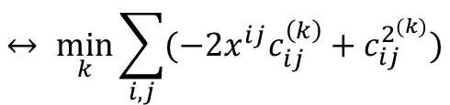

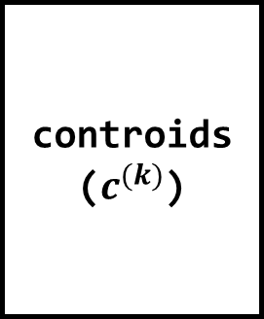
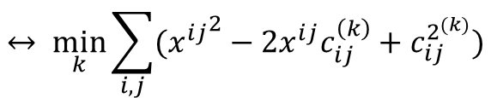


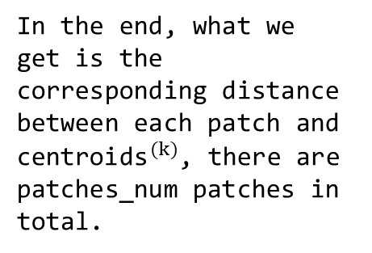
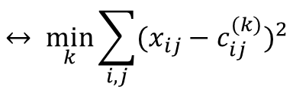



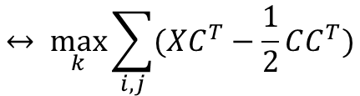
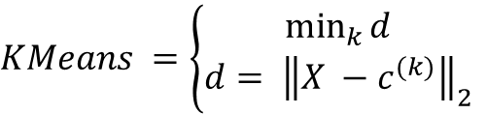
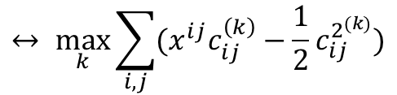

patch_len
(w*w = 36)
patch_len
(w*w = 36)
patches
($X$)
controids
($c^{(k)}$)
$KMeans =\left\{\begin{aligned}\min_{k}{d} \\ d= {\left\|X −c^{(k)}\right\|}_{2}\end{aligned}\right.$
Centroids_num
(g_K = 1600)
patches_num
(patches_num = 10000)
$$= \min_{k}{{\left\|X−c^{(k)}\right\|}_{2}}$$
$$↔ \min_{k}{\sum_{i, j}{{(x_{ij}−c_{ij}^{(k)})}^{2}}}$$
$$↔ \min_{k}{\sum_{i, j}{({x^{ij}}^{2}−2x^{ij}c_{ij}^{\left(k\right)}+c_{ij}^{2^{(k)}})}}$$
$$X:\left(patches_{num}, patch_{len}\right)$$
$$C:\left(centroids_{num}, patch_{len}\right)$$
$$XC^{T}:\left(patches_{num},centroids_{num}\right)$$
$$↔ \min_{k}{\sum_{i, j}{(−2x^{ij}c_{ij}^{\left(k\right)}+c_{ij}^{2^{(k)}})}}$$
In the end, what we get is the corresponding distance between each patch and ${\text{centroids}}^{(k)}$, there are patches_num patches in total.
$$CC^{T}:(centroids_{num},centroids_{num})$$
$$XC^{T}−\frac{1}{2}CC^{T}:(patches_{num},centroids_{num})$$
$$↔ \max_{k}{\sum_{i, j}{(x^{ij}c_{ij}^{\left(k\right)}−{\frac{1}{2}c}_{ij}^{2^{(k)}})}}$$
$$↔ \max_{k}{\sum_{i, j}{(XC^{T}−\frac{1}{2}CC^{T})}}$$

Slide 2

centroids_num
(g_K = 1600)
patches_num
(patches_num = 10000)
patch_len
(w*w = 36)
patch_centroids_map
patch_centroids_map.T
patches
($X$)
centroids_num
(g_K = 1600)
patches_num
(patches_num = 10000)
*
patches_num
(patches_num = 10000)
Because in the matrix operation, the row vector of patches_num whose patch_centroids_map.T
matrix satisfying k == k_idx is multiplied by all the column vectors of the patches matrix which have patch_len totals, the row vector of the new matrix is ​​obtained.
Therefore, the centroid_patch_map matrix is ​​the new matrix of the sum of the centroids and their corresponding patches.
patch_len
(w*w = 36)
centroid_patch_map
centroids_num
(g_K = 1600)

